Slide 1
Group O
David Sorensen, Sam Anderson, Will Cobian-Ruelas

Slide 2
Introduction
Question: Do expert grades for high school football correlate to collegiate level success?
Analysis: Compare high school football recruiting rankings and college statistics for offensive skills player.

Slide 3
The Data
Multiple years of high school recruit rankings and subsequent years of collegiate level performance
Complete data for the years 2006-2014 was found
Sources
College Football Stats
Individual player stats
Excel files ready for download
ESPN College Football High School Recruits
Individual high school grades
HTML Tables
Scrape data
Multiple CSVs with relevant information generated per year

Slide 4
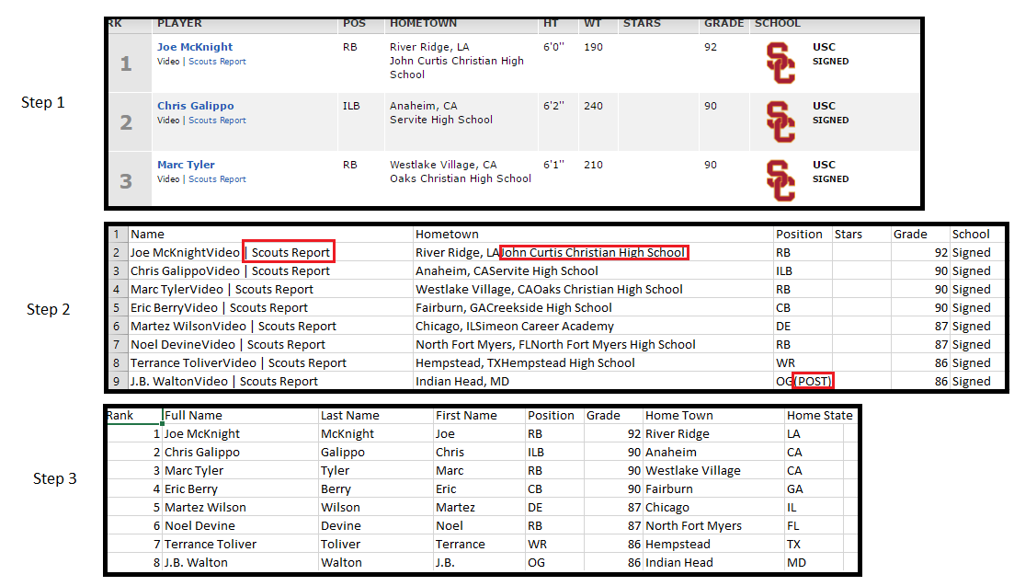
Cleaning Data

Slide 5
Functions
getRecruits()
getCombinedRecruits()
getCombinedPlayers()
getRecruitStats(dfRecruits)
createYearlyPlots()
createCareerPlots()
plotMeanDifference()

Slide 6
Outcome
Checked difference between original rankings and end of year rankings
Two different outcomes based on treatment of NA
With NA = 49, rankers weren’t very accurate
Unfairly penalized for lack of rankings
With NA removed, rankers were more accurate
Takes only their actual ranking opinions into account

Slide 7
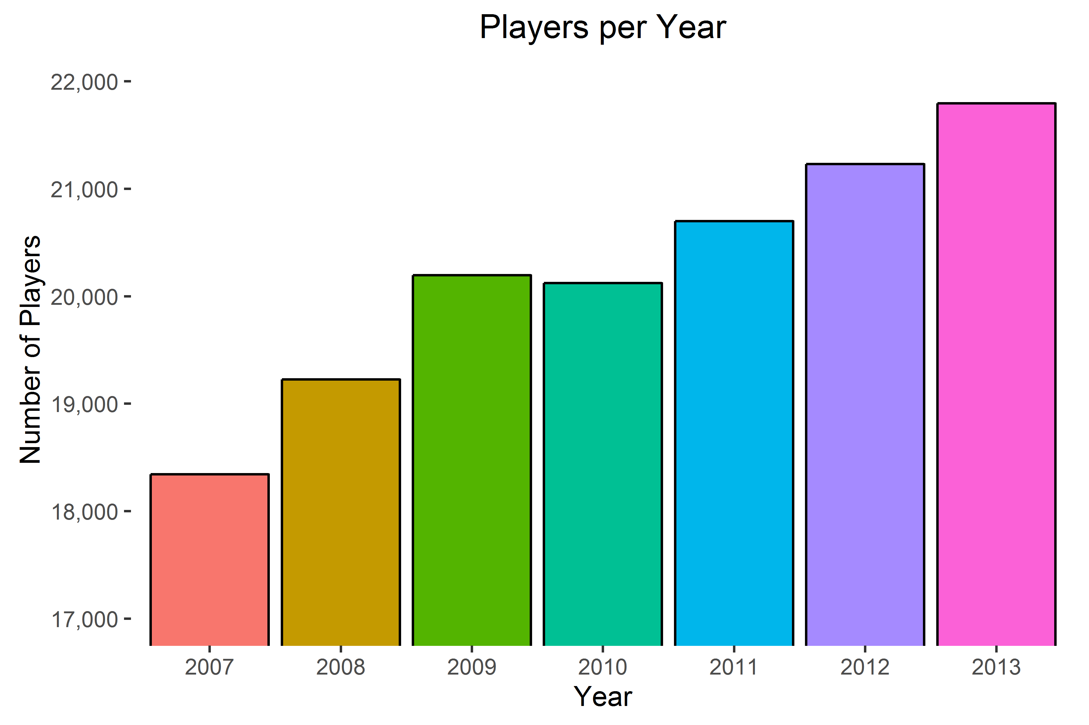
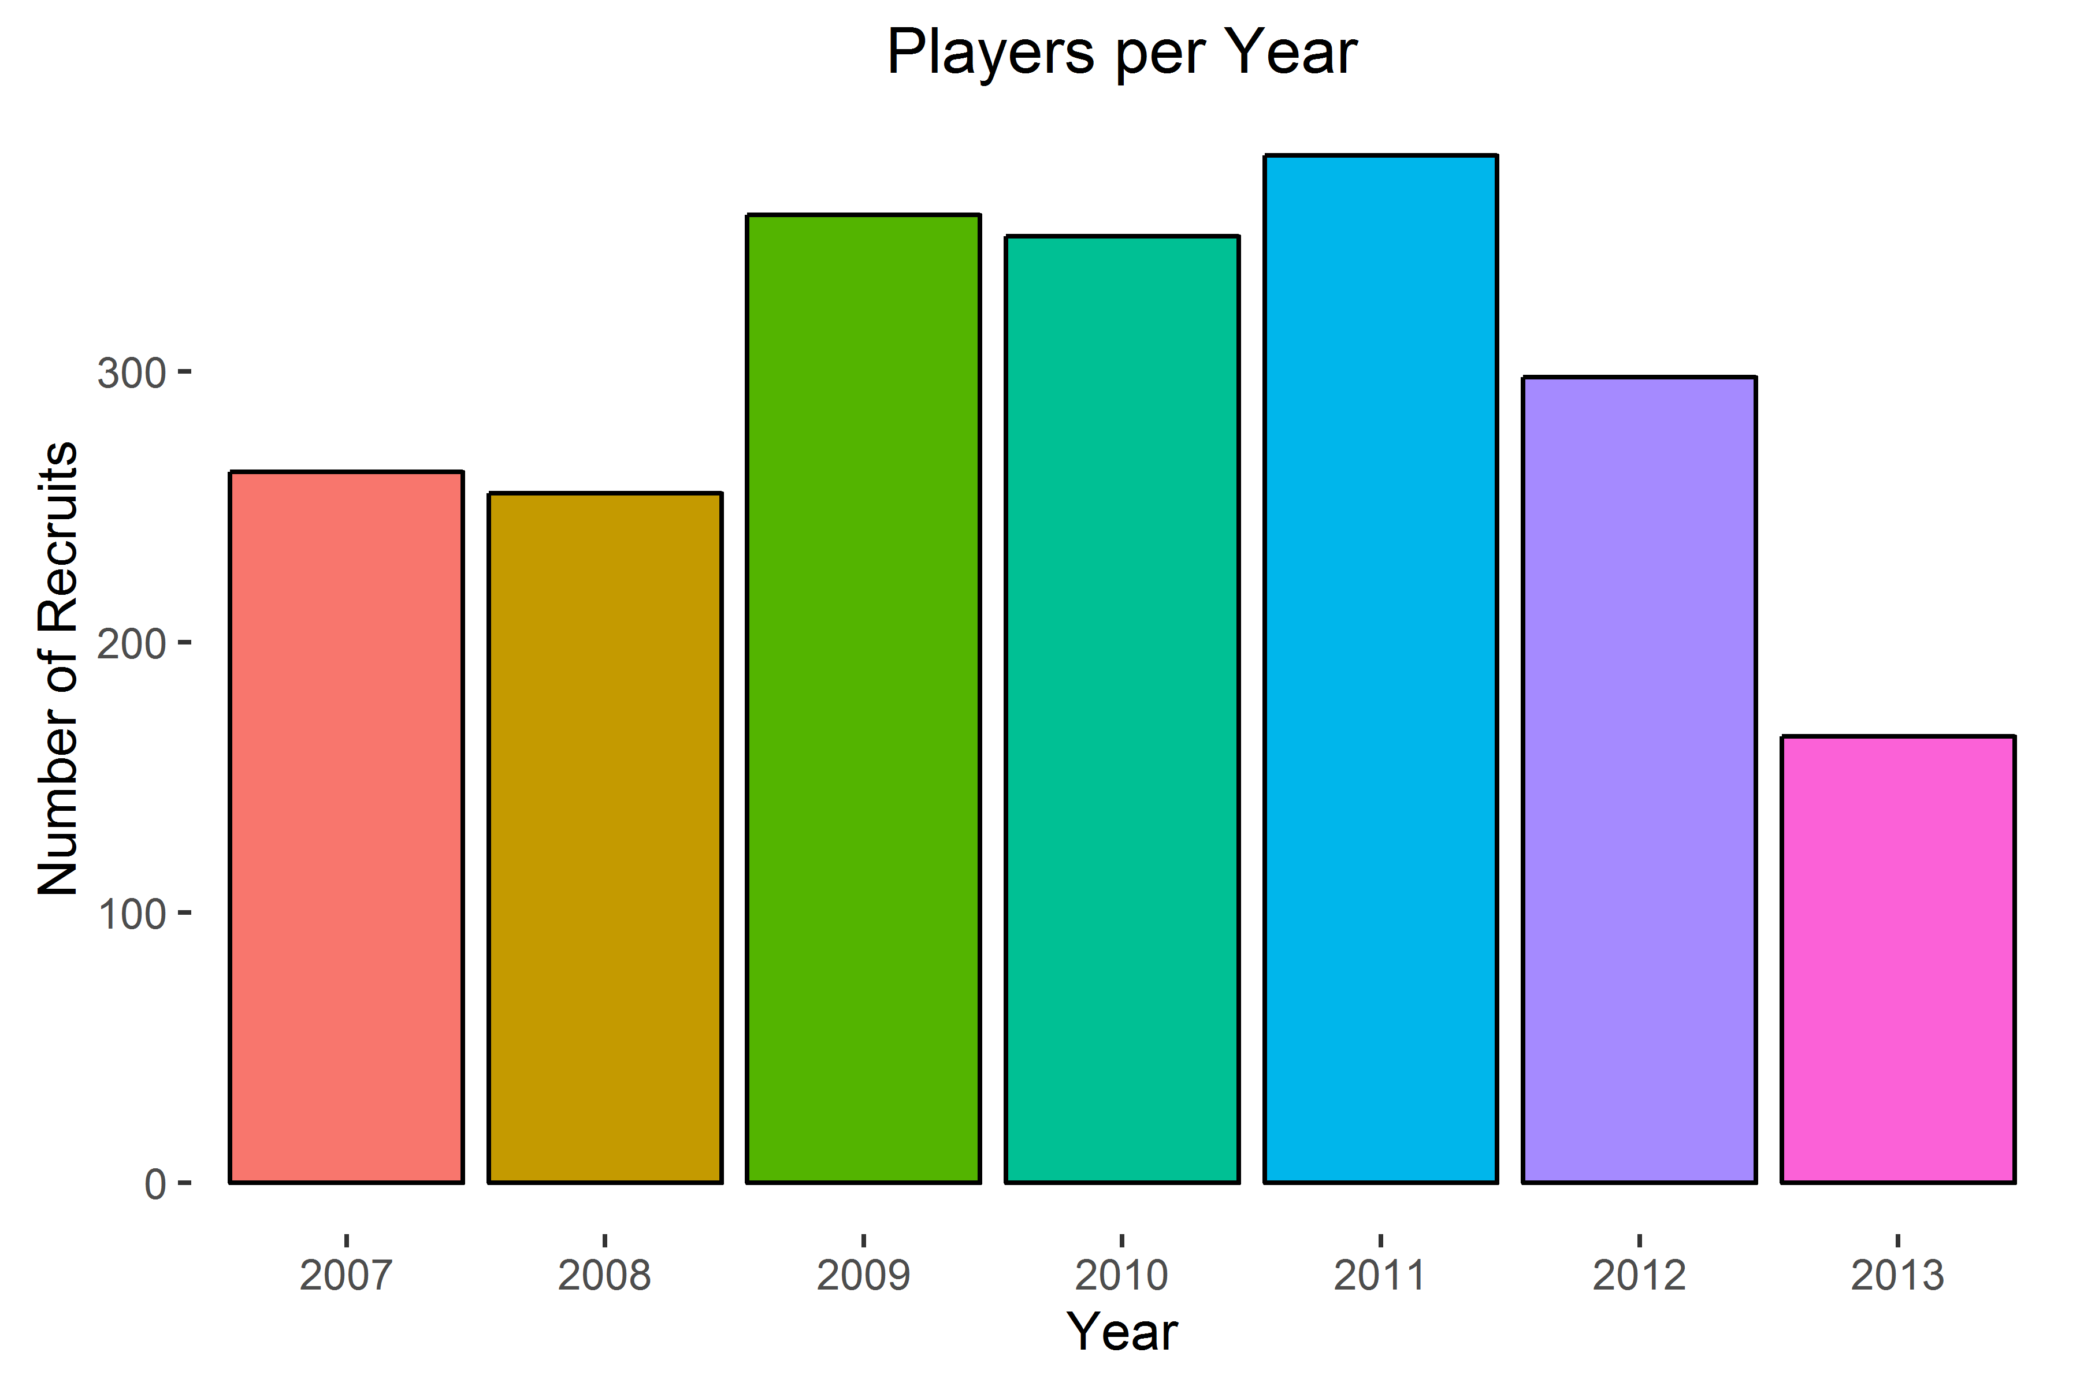
Player Pool

Slide 8
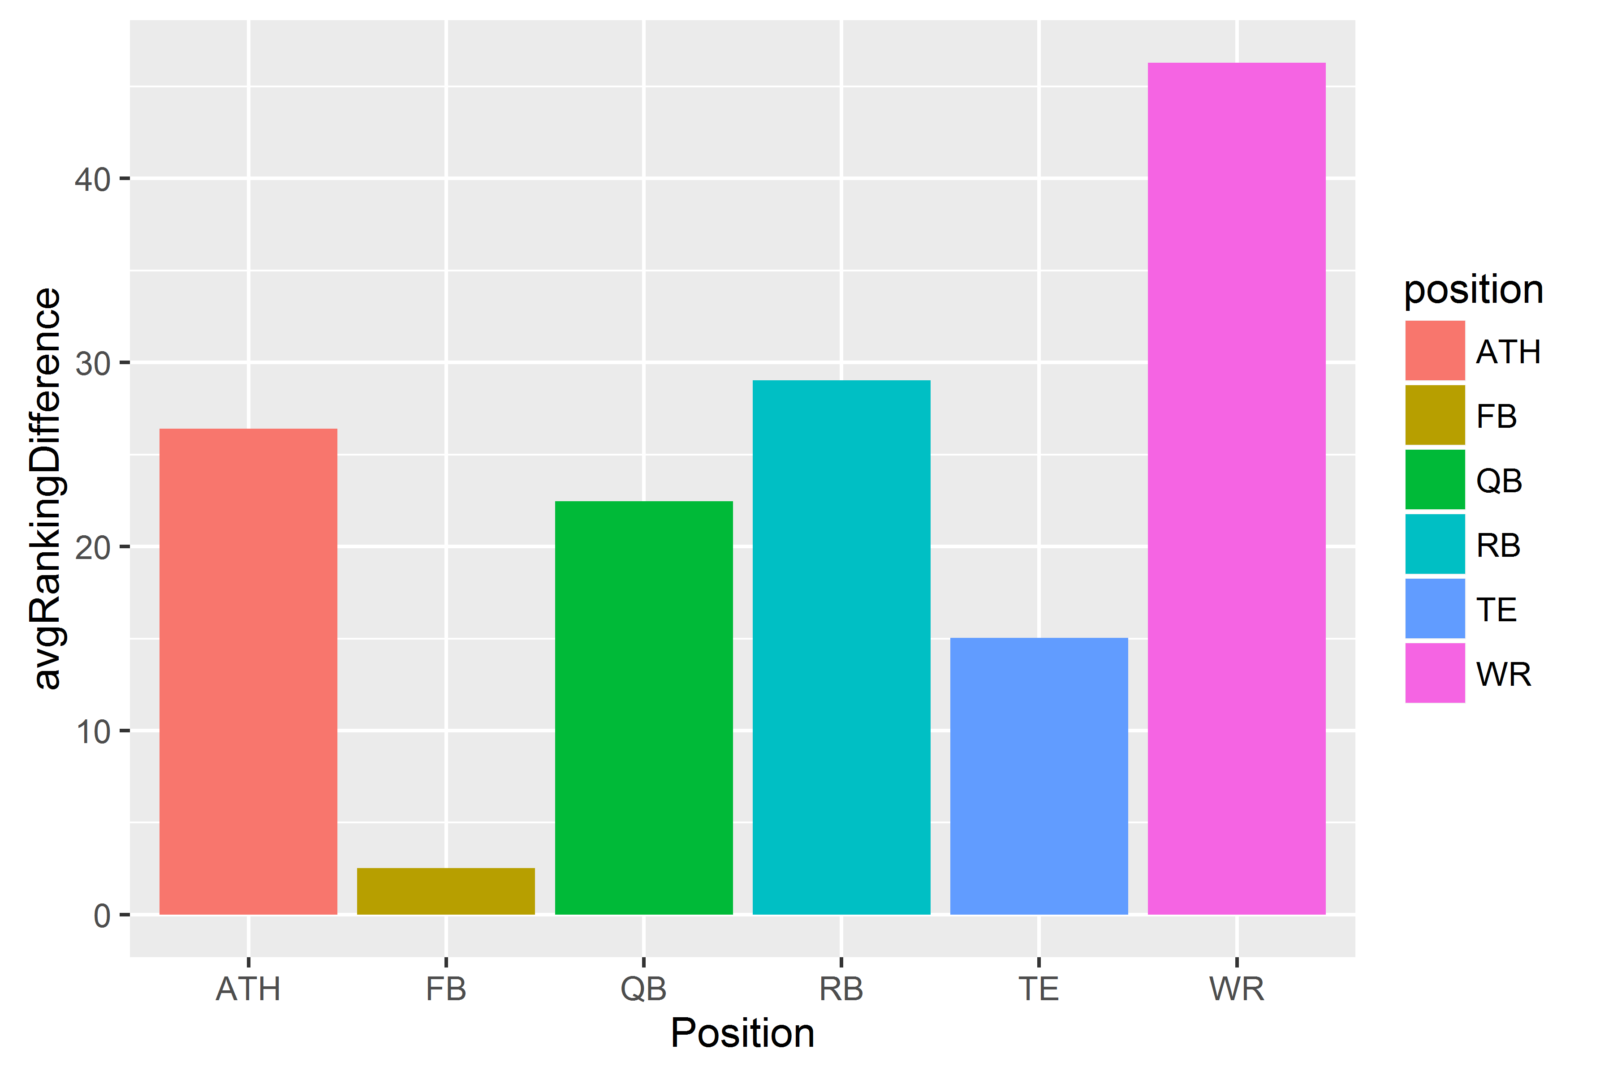
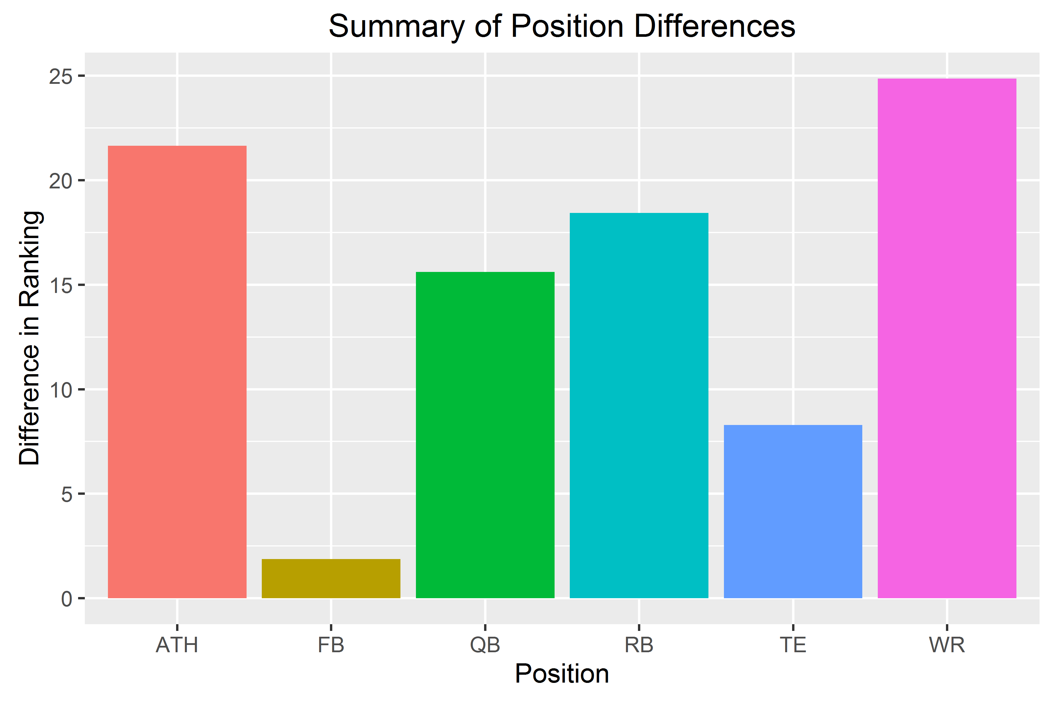
By Position

Slide 9
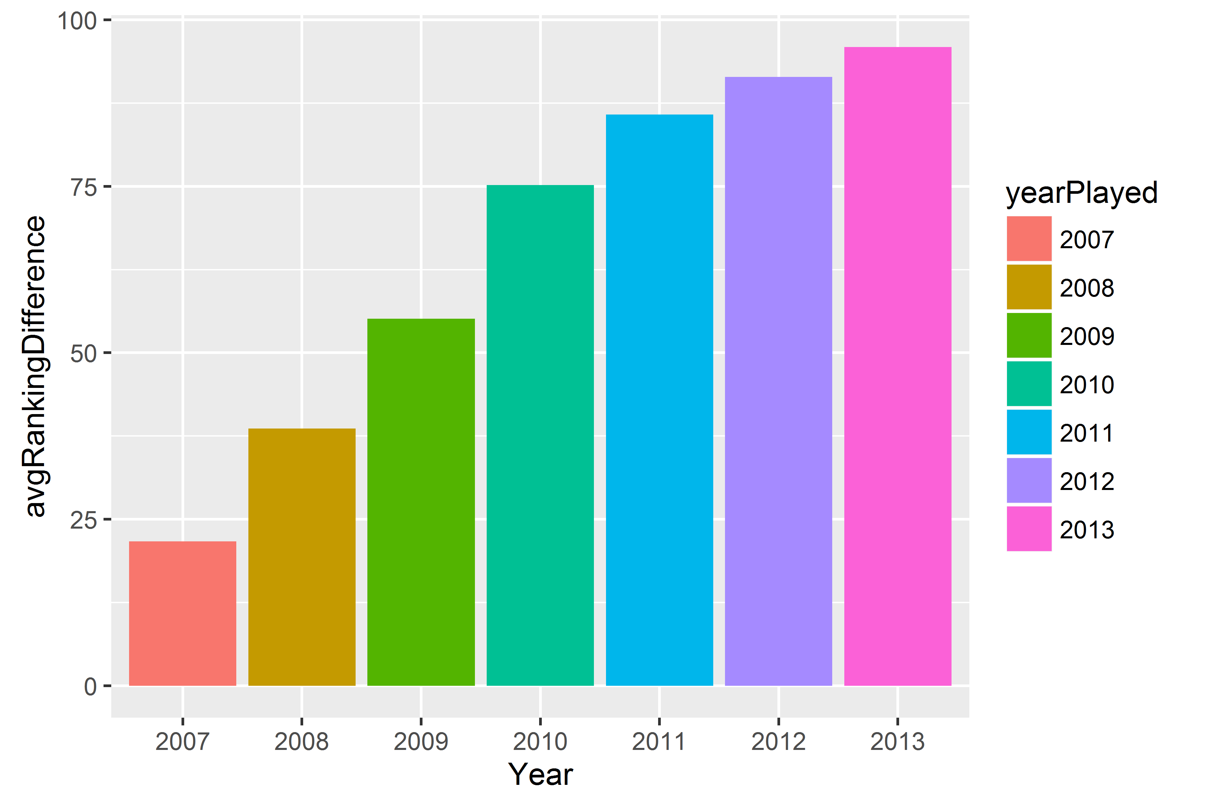
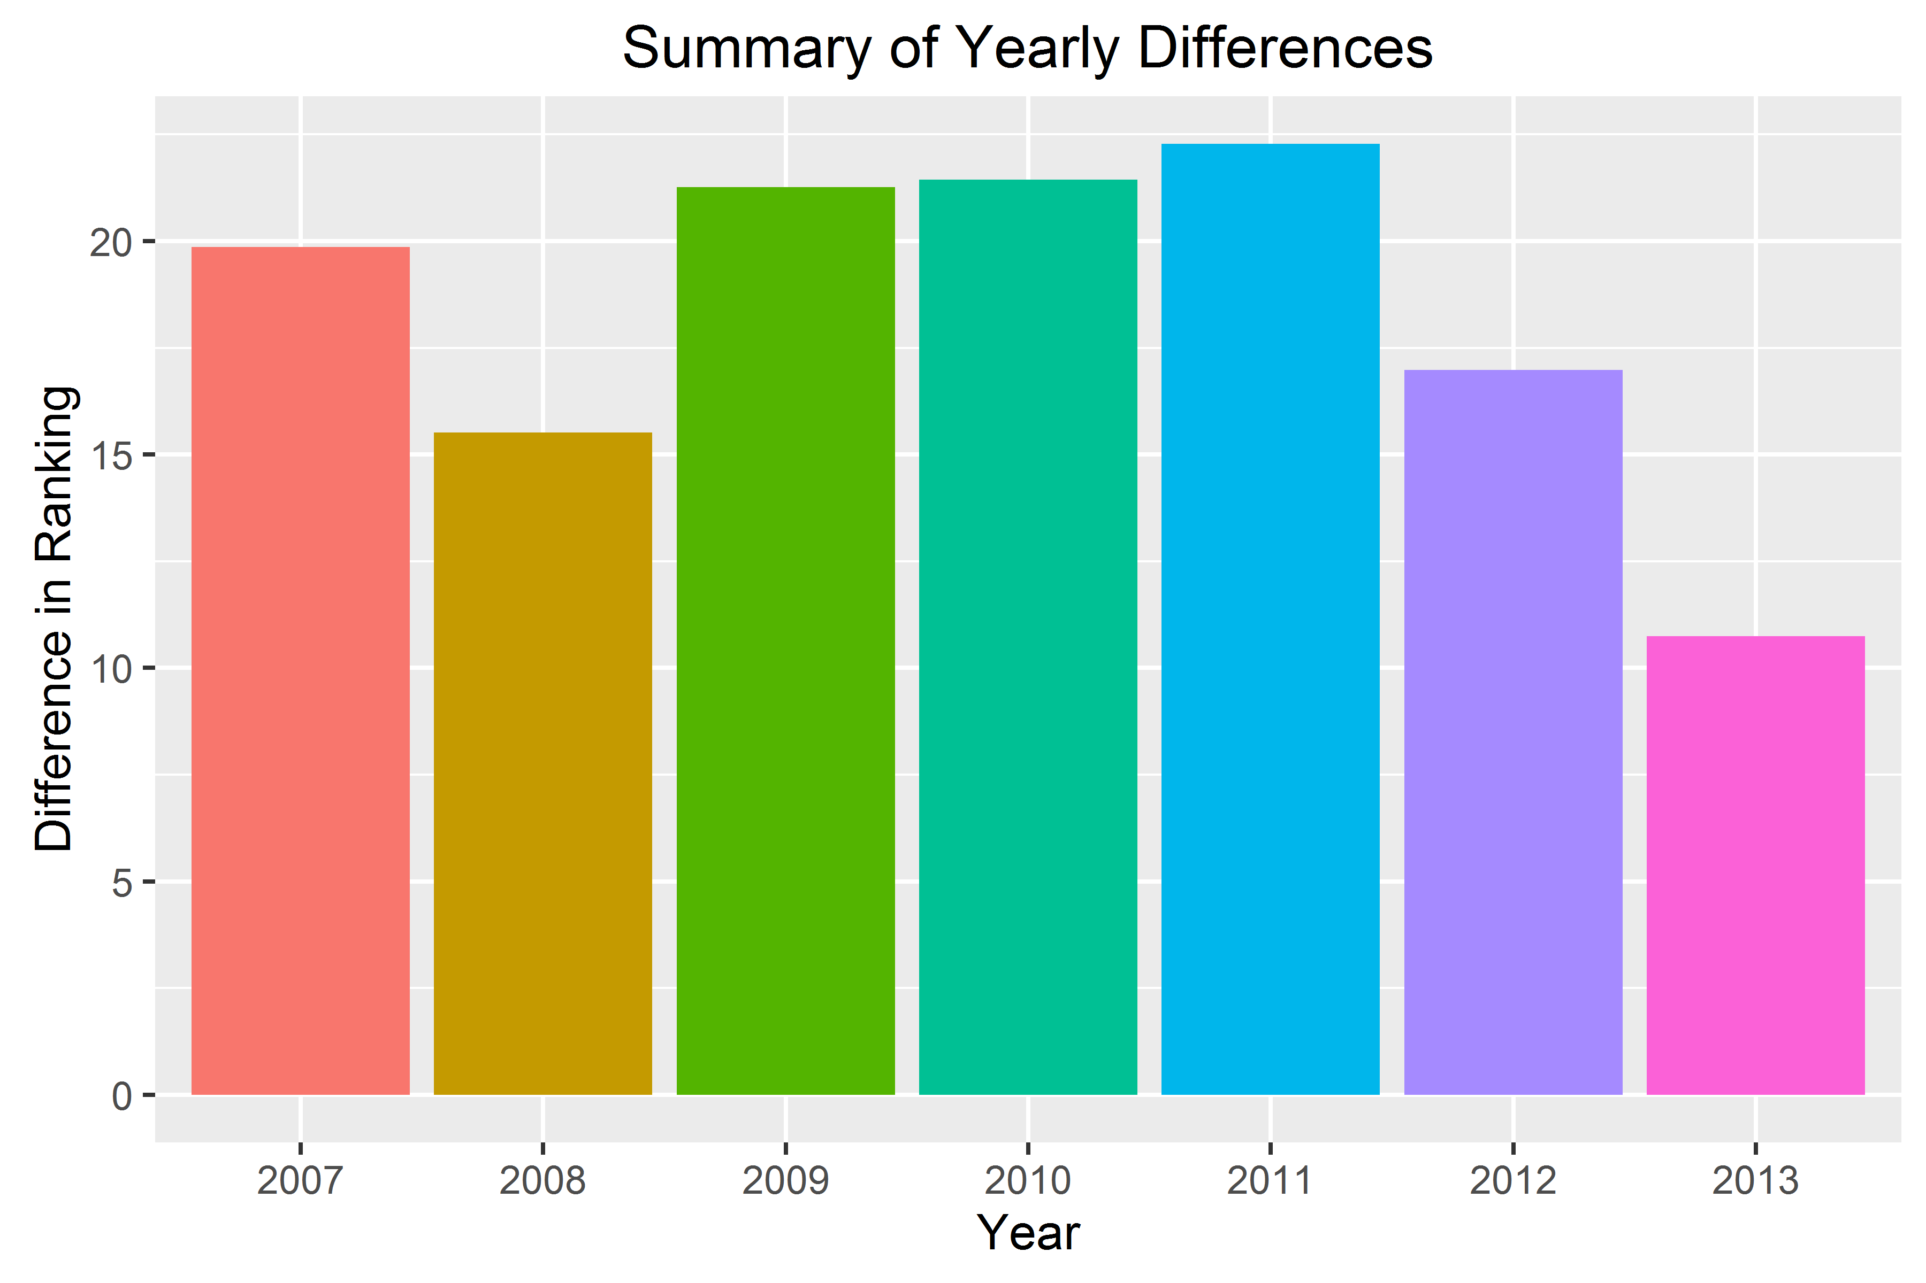
By Year

Slide 10
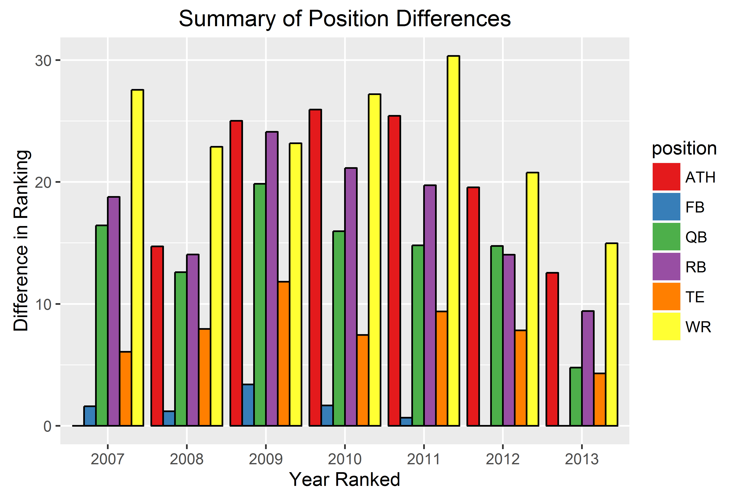
Combined Position and Year

